Slide 1
Representation of Discrete Structures

Slide 2
Data structure
Computer program is written for a given problem, is problem is made simpler and it can be analyzed in terms of subproblems
Program should be modular – consists of small parts
Solution to problem consists of two classes of concepts
Data structures
Operations on discrete structures
Data – set of elementary items/atoms of data
Data structures -The ways in which these data items/atoms are structured

Slide 3
Operations on data structure
Create – eg declaration statement
Destroy/Delete
Update/change/add/delete

Slide 4
Data classification
Batches – unordered set of objects
Fixed or variable in size
size – no of data items
Frequently used
Vector - ordered set of objects
Fixed number of objects
No addition/deletion
Plexes- unordered set of objects
Variable in size
Addition/deletion can be performed
Linear plex –linear list
Nonlinear plex - trees

Slide 5
Stack
Subclass of plex in which addition & deletion of elements is done in any position
Stack is a linear data structure which follows a particular order in which the operations are performed.
The order may be LIFO(Last In First Out) or FILO(First In Last Out).
Push: Adds an item in the stack. If the stack is full, then it is said to be an Overflow condition.
Pop: Removes an item from the stack. The items are popped in the reversed order in which they are pushed. If the stack is empty, then it is said to be an Underflow condition.
Peek or Top: Returns top element of stack.
isEmpty: Returns true if stack is empty, else false.

Slide 6
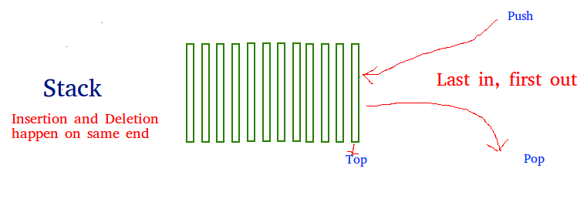

Slide 7
Queue
Subclass of plex
Deletions performed at one end and addition at the other
Queue is a linear structure which follows a particular order in which the operations are performed.
The order is First In First Out (FIFO). A good example of a queue is any queue of consumers for a resource where the consumer that came first is served first.
The difference between stacks and queues is in removing.
In a stack we remove the item the most recently added; in a queue, we remove the item the least recently added.

Slide 8
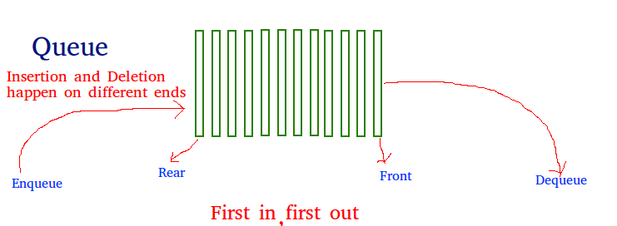

Slide 9
Storage structures
The way in which particular data structure is represented in the memory of computer
The main memory of the computer is organized in the sequence of words
Each Word is 8 to 64 bits
Each Word contents can referenced by using address
2 possible ways to obtain the address
Computed address- compute the address of element of the array
Link/pointer address – store somewhere in the memory of the computer

